Slide 1
Proiect de an la TMPS
Naghiev Raghim

Slide 2
Cuprins
Implementarea Singleton
Implementarea Decorator
Implementarea Adapter
Implementarea Observer
Implementarea Mediator
Implementarea Command

Slide 3
Singleton
Services
Controller
async createTask(createTaskDto: CreateTaskDto, user: User): Promise<Task> {
const { title, description } = createTaskDto;
const task = this.tasksRepository.create({
title,
description,
status: TaskStatus.OPEN,
user,
});
await this.tasksRepository.save(task);
this.observable.notifyObservers(task);
return task;
}
@Post()
createTask(
@Body() createTaskDto: CreateTaskDto,
@GetUser() user: User,
): Promise<Task> {
this.logger.verbose(
`User "${user.username}" created a task. Data: ${JSON.stringify(
createTaskDto,
)}`,
);
// return this.tasksService.createTask(createTaskDto, user);
return this.taskMediator.createTaskWithNotification(createTaskDto, user);
}

Slide 4
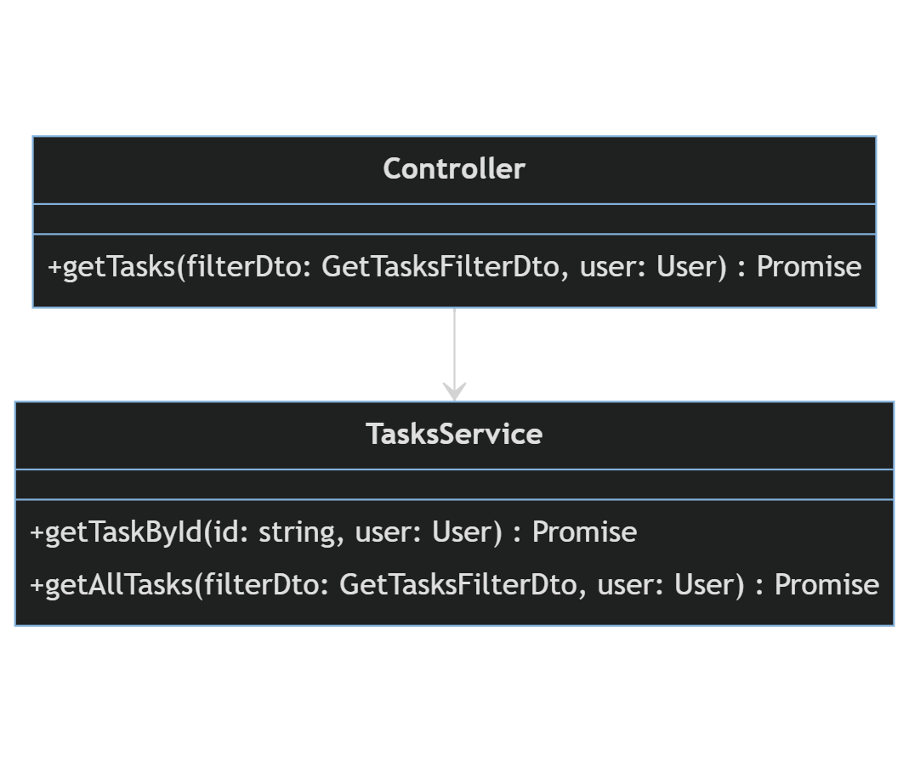
Singleton

Slide 5
Decorator
Decorator
Implementation
export const GetUser = createParamDecorator(
(data, ctx: ExecutionContext): User => {
const req = ctx.switchToHttp().getRequest();
return req.user;
});
@Get()
getTasks(
@Query() filterDto: GetTasksFilterDto,
@GetUser() user: User,
): Promise<Task[]> {
this.logger.verbose(`User "${user.username}" retrieving all tasks`);
return this.tasksService.getAllTasks(filterDto, user);
}

Slide 6
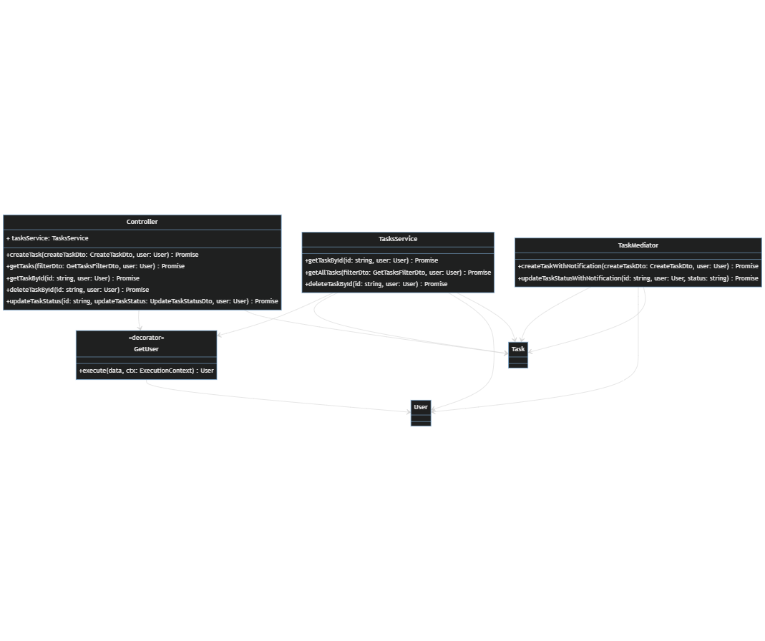
Decorator

Slide 7
Adapter
Adapter
Implementation
@Injectable()
export class EmailServiceAdapter implements NotificationService {
constructor(private readonly emailService: EmailService) {}
async sendNotification(
recipient: string,
subject: string,
body: string,
): Promise<void> {
await this.emailService.sendEmail(recipient, subject, body);
}
}
async deleteTaskById(id: string, user: User): Promise<void> {
const found = await this.tasksRepository.delete(id);
if (!found) {
throw new NotFoundException(`Task with this '${id}' don't exist.`);
}
await this.notificationService.sendNotification(
user.username,
`Task deleted`,
`User "${user.username}" deleted one task.`,
);
}

Slide 8
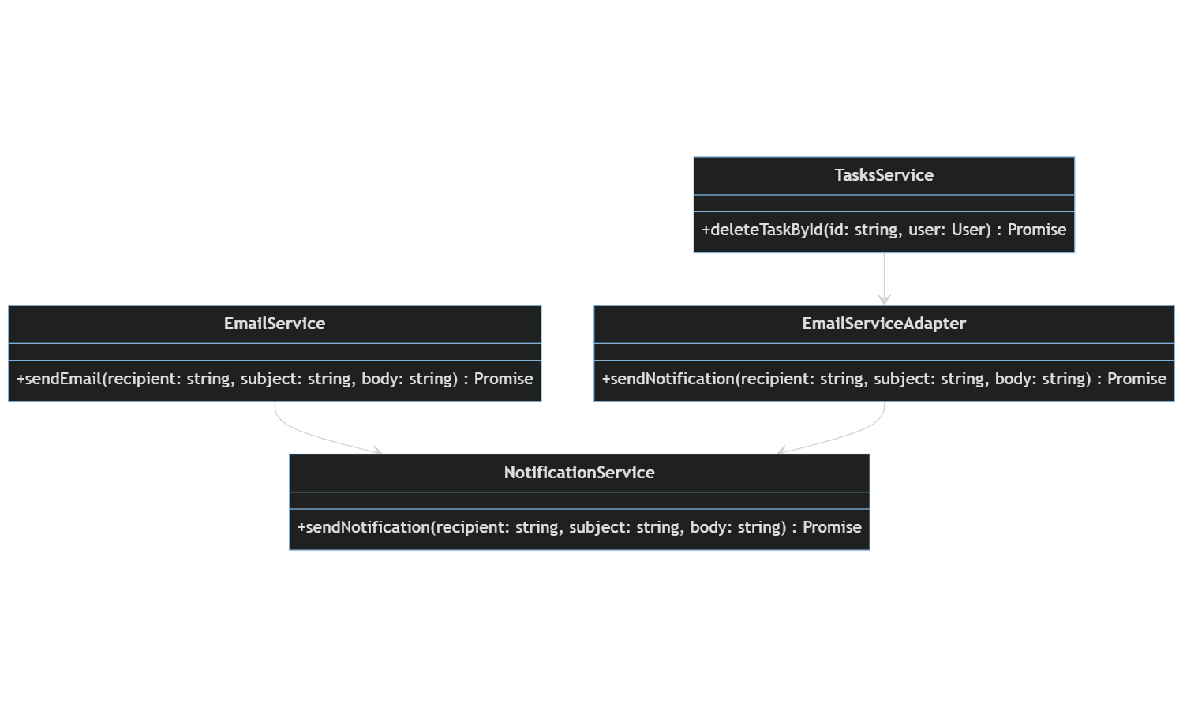
Adapter

Slide 9
Observer
Observer
Implementation
import { Task } from 'tasks/entities/task.entity';
import { Observer } from '../interfaces/observer';
export class Observable {
private observers: Observer[] = [];
addObserver(observer: Observer): void {
this.observers.push(observer);
}
notifyObservers(task: Task): void {
this.observers.forEach((observer) => {
observer.update(task);
});
}
}
async createTask(createTaskDto: CreateTaskDto, user: User): Promise<Task> {
const { title, description } = createTaskDto;
const task = this.tasksRepository.create({
title,
description,
status: TaskStatus.OPEN,
user,
});
await this.tasksRepository.save(task);
this.observable.notifyObservers(task);
return task;
}

Slide 10
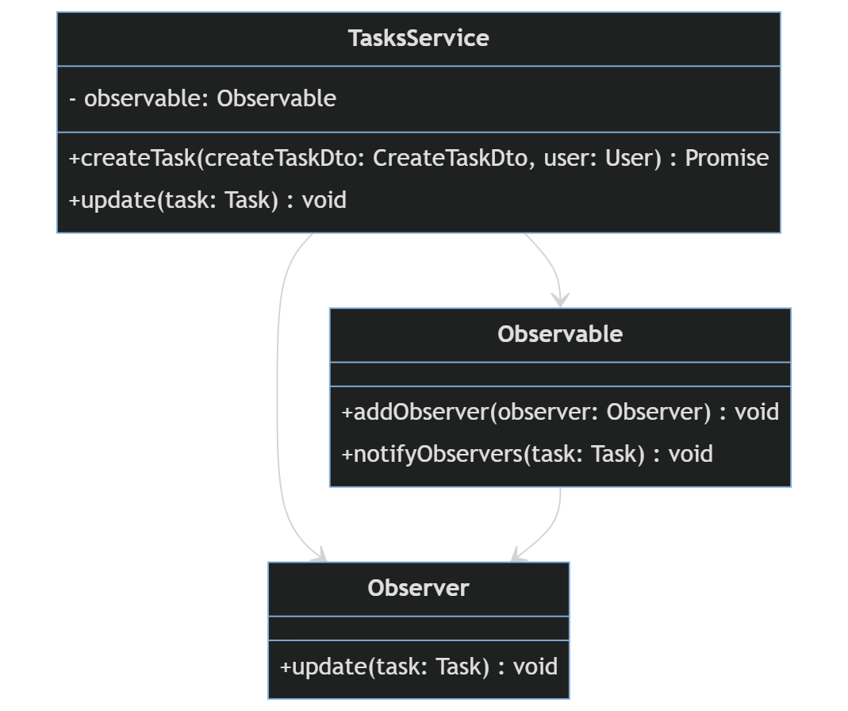
Observer

Slide 11
Mediator
Mediator
Implementation
@Injectable()
export class TaskMediator {
private emailService: EmailService;
private tasksService: TasksService;
constructor(emailService: EmailService, tasksService: TasksService) {
this.emailService = emailService;
this.tasksService = tasksService;
}
async createTaskWithNotification(
createTaskDto: CreateTaskDto,
user: User,
): Promise<Task> {
const task = await this.tasksService.createTask(createTaskDto, user);
const emailSubject = 'New Task Created';
const emailBody = `A new task with title "${task.title}" has been created.`;
await this.emailService.sendEmail(user.username, emailSubject, emailBody);
return task;
}
@Patch('/:id/status')
updateTaskStatus(
@Param('id') id: string,
@Body() updateTaskStatus: UpdateTaskStatusDto,
@GetUser() user: User,
): Promise<Task> {
const { status } = updateTaskStatus;
// return this.tasksService.updateTaskStatus(id, user, status);
return this.taskMediator.updateTaskStatusWithNotification(id, user, status);
}

Slide 12
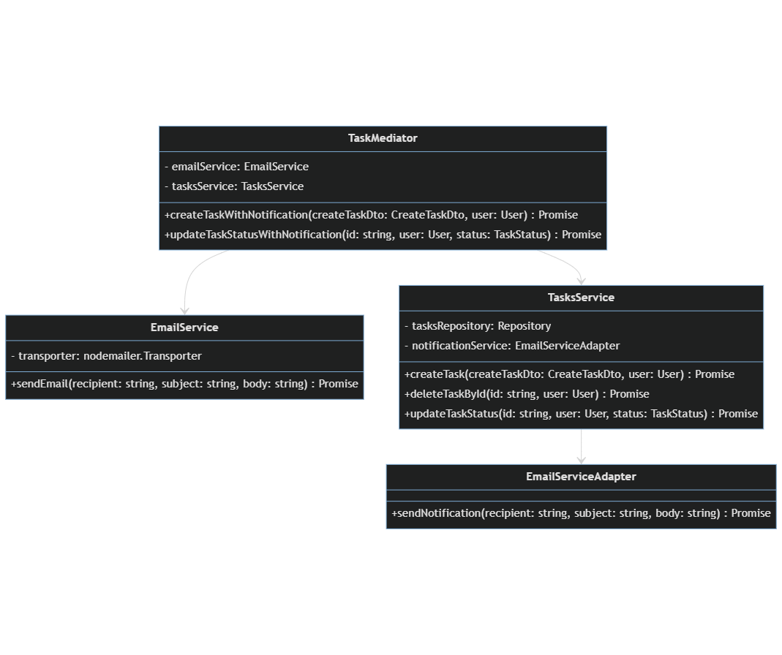
Mediator

Slide 13
Command
Command
Implementation
export class SignUpCommand implements Command {
constructor(
private authService: AuthService,
private authCredentialsDto: AuthCredentialsDto,
) {}
async execute(): Promise<void> {
await this.authService.signUp(this.authCredentialsDto);
}
}
@Post('/signup')
async signUp(@Body() authCredentialsDto: AuthCredentialsDto): Promise<void> {
// return this.authService.signUp(authCredentialsDto);
const command = new SignUpCommand(this.authService, authCredentialsDto);
return await command.execute();
}

Slide 14
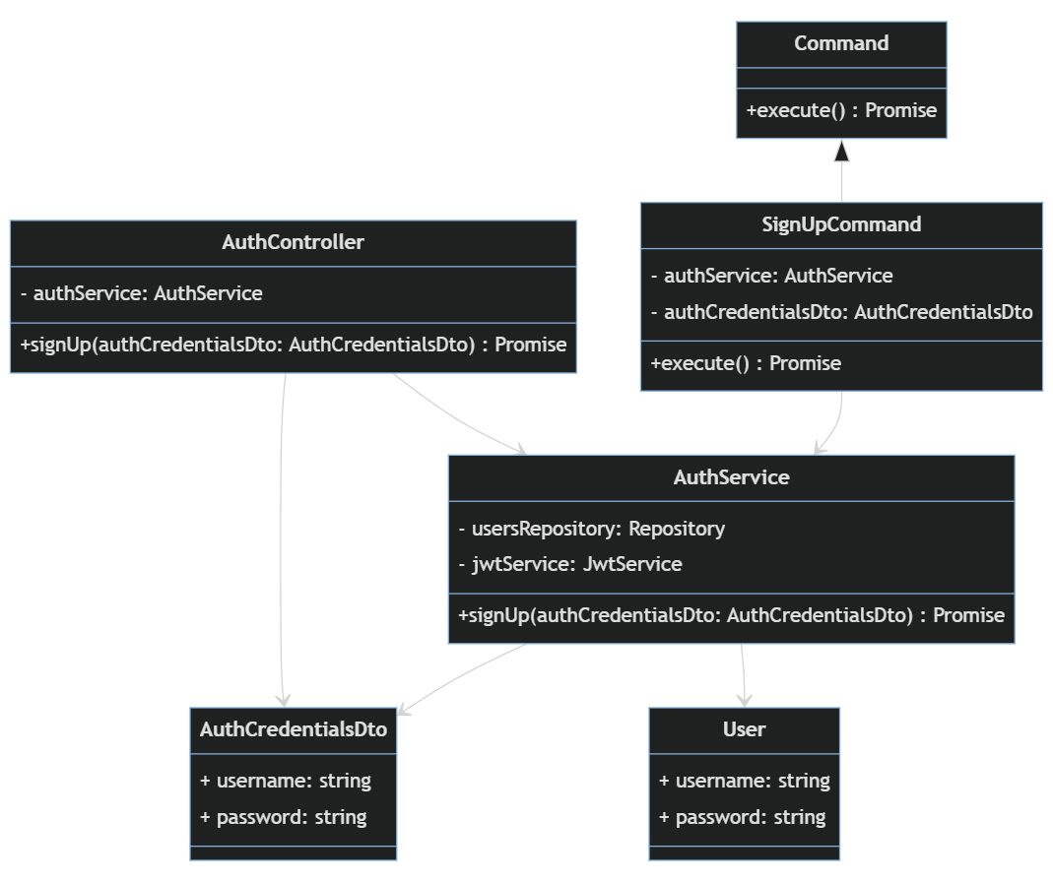
Command

Slide 15
Thank You <3

